Slide 1

Clicker Questions
Chapter 9
Gases: Their Properties and Behavior
Donald Linn
Indiana University–
Purdue University Fort Wayne
Fort Wayne, IN

Slide 2
Which of the following is not equivalent to
1 atm pressure?
a) 10 cm Hg
b) 14.7 lb/in²
c) 101 kPa
d) 760 mm Hg
e) None of the above
Notes:
Answer: a

Slide 3
Which of the following is not equivalent to
1 atm pressure?
a) 10 cm Hg
b) 14.7 lb/in²
c) 101 kPa
d) 760 mm Hg
e) None of the above
Notes:
Answer: a

Slide 4
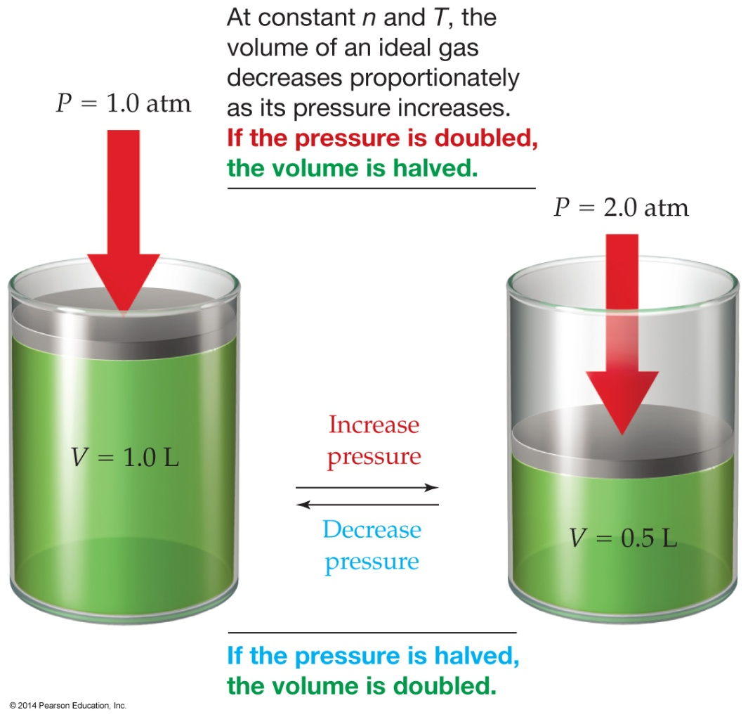
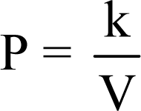
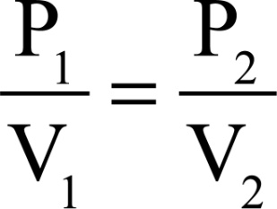

Which of the following is an incorrect statement of Boyle’s law?
a) The volume of a fixed amount of ideal gas varies inversely with pressure at constant temperature.
b)
c)
d)
e)
None of the above
Notes:
Answer: c

Slide 5
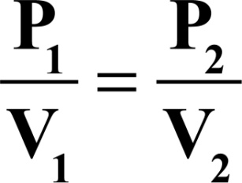
Which of the following is an incorrect statement of Boyle’s law?
a) The volume of a fixed amount of ideal gas varies inversely with pressure at constant temperature.
b)
c)
d)
e)
None of the above
Notes:
Answer: c

Slide 6
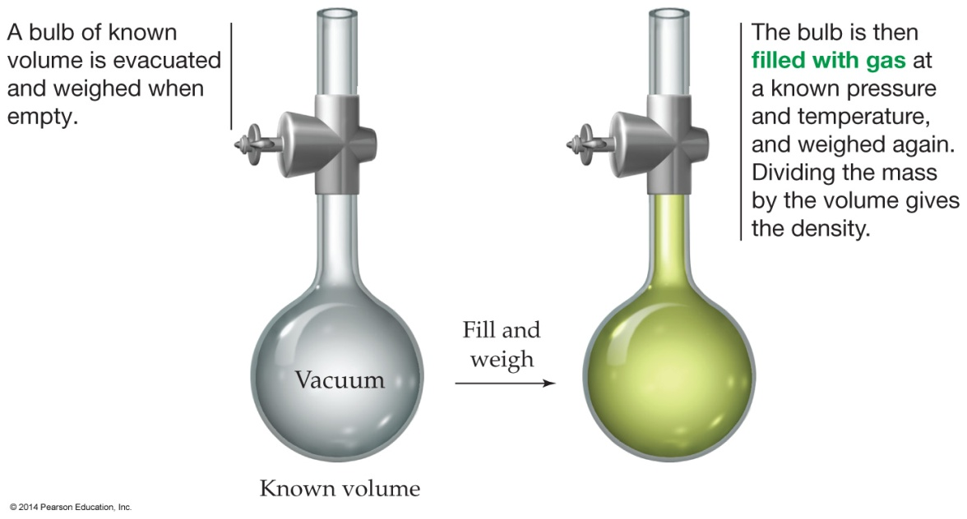
If a bulb was filled with
20 g of gas, which of
the gases below would record the highest pressure? Temperature and volume are the same.
a) He
d) Both a and b
b) Ar
e) All will have the same pressure.
c) Br₂
Notes:
Answer: a

Slide 7
If a bulb was filled with
20 g of gas, which of
the gases below would record the highest pressure? Temperature and volume are the same.
20 g
a) He
d) Both a and b
b) Ar
e) All will have the same pressure.
c) Br₂
Notes:
Answer: a

Slide 8
If a bulb was filled with
1 mol of gas, which of
the gases below would record the highest pressure? Temperature and volume are the same.
1 mol
a) He
d) Both a and b
b) Ar
e) All will have the same
c) Br₂
Notes:
Answer: e

Slide 9
If a bulb was filled with
1 mol of gas, which of
the gases below would record the highest pressure? Temperature and volume are the same.
1 mol
a) He
d) Both a and b
b) Ar
e) All will have the same
c) Br₂
Notes:
Answer: e

Slide 10
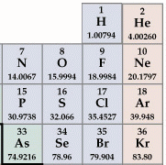
Which has the greatest mass?
a) 22.4 L of He at STP
b) 1 mole of N₂ at STP
c) 2 moles of H₂ at STP
d) 20 g of Ne
e) All have the same mass.
Notes:
Answer: b

Slide 11
Which has the greatest mass?
a) 22.4 L of He at STP
b) 1 mole of N₂ at STP
c) 2 moles of H₂ at STP
d) 20 g of Ne
e) All have the same mass.
Notes:
Answer: b

Slide 12
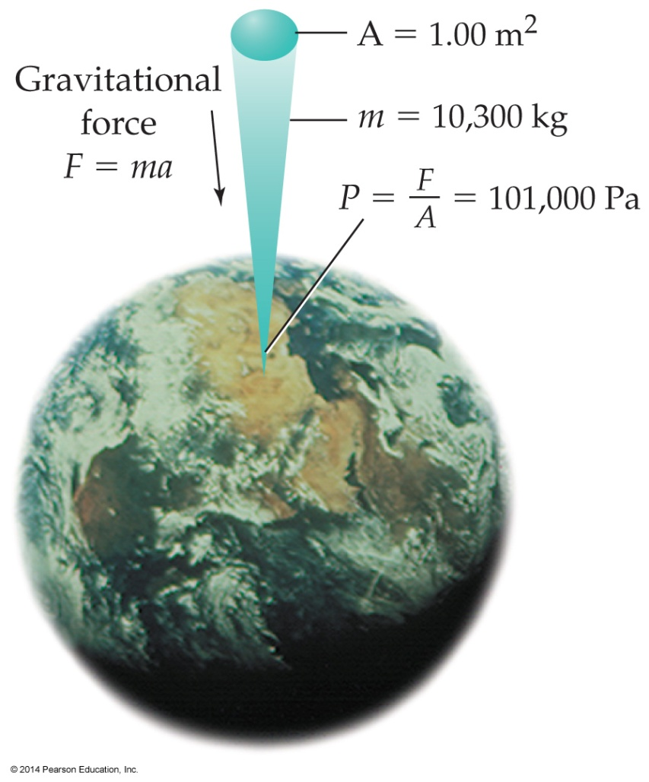
The lowest barometric pressure recorded in the United States during a hurricane in 1935 was 669.3 mmHg. What is this pressure in atm and kPa?
a) 1.136 atm, 115.2 kPa
b) 0.8807 atm, 89.23 kPa
c) 0.8807 atm, 88.07 kPa
d) 0.8927 atm, 89.27 kPa
e) 0.6693 atm, 67.83 kPa
Notes:
Answer: b

Slide 13
The lowest barometric pressure recorded in the United States during a hurricane in 1935 was 669.3 mmHg. What is this pressure in atm and kPa?
a) 1.136 atm, 115.2 kPa
b) 0.8807 atm, 89.23 kPa
c) 0.8807 atm, 88.07 kPa
d) 0.8927 atm, 89.27 kPa
e) 0.6693 atm, 67.83 kPa
Notes:
Answer: b

Slide 14
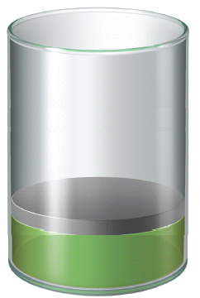
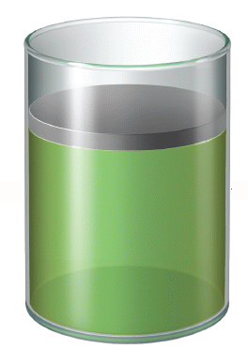
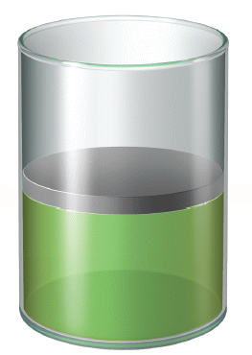
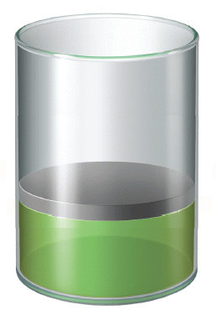
To the right is a cylinder which contains 0.50 mol of gas at 1.0 atm and 250 K. Which of the figures below represents the situation where the amount of gas
is 0.25 mol at 1 atm and 500 K?
a
b
c
d
Notes:
Answer: d

Slide 15
To the right is a cylinder which contains 0.50 mol of gas at 1.0 atm and 250 K. Which of the figures below represents the situation where the amount of gas
is 0.25 mol at 1 atm and 500 K?
a
b
c
d
Notes:
Answer: d

Slide 16
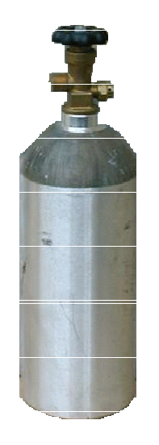
When you increase the temperature of a constant volume of gas from 25 °C to 50 °C, the pressure of the gas
a) doubles.
b) quadruples.
c) halves.
d) remains the same.
4 L
4 L
e) None of these answers
25 °C
50 °C
Notes:
Answer: e

Slide 17
When you increase the temperature of a constant volume of gas from 25 °C to 50 °C, the pressure of the gas
a) doubles.
b) quadruples.
c) halves.
d) remains the same.
4 L
4 L
e) None of these answers
25 °C
50 °C
Notes:
Answer: e

Slide 18
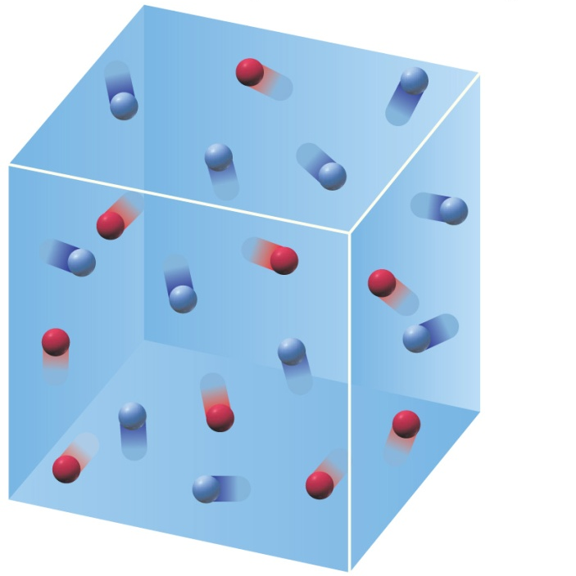
A mixture of two gases (A and B) has a mole fraction of A equaling 0.48. If the volume of the vessel is increased by two and the Kelvin temperature is decreased to half the initial temperature, what is the mole fraction of A?
a) 0.12
d) 0.96
b) 0.24
e) 1.92
c) 0.48
Notes:
Answer: c

Slide 19
A mixture of two gases (A and B) has a mole fraction of A equaling 0.48. If the volume of the vessel is increased by two and the Kelvin temperature is decreased to half the initial temperature, what is the mole fraction of A?
a) 0.12
d) 0.96
b) 0.24
e) 1.92
c) 0.48
Notes:
Answer: c

Slide 20
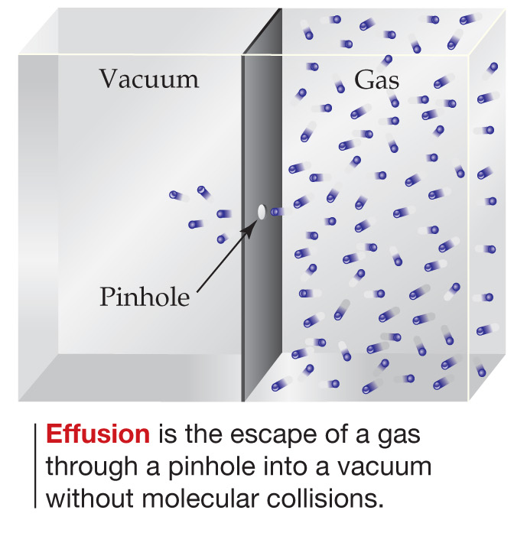
Br₂, with molar mass 159.8 g mol^{–1}, effuses twice as fast as which of the following rare gases?
a) Ne, 20.18 g mol^{–1}
b) Ar, 39.95 g mol^{–1}
c) Kr, 83.80 g mol^{–1}
d) Xe, 131.3 g mol^{–1}
e) Rn, 222 g mol^{–1}
Notes:
Answer: b

Slide 21
Br₂, with molar mass 159.8 g mol^{–1}, effuses twice as fast as which of the following rare gases?
a) Ne, 20.18 g mol^{–1}
b) Ar, 39.95 g mol^{–1}
c) Kr, 83.80 g mol^{–1}
d) Xe, 131.3 g mol^{–1}
e) Rn, 222 g mol^{–1}
Notes:
Answer: b

Slide 22
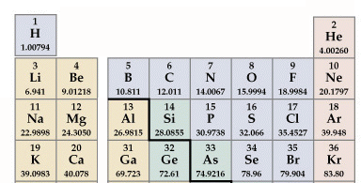
Neon is about as dense as argon.
a) half
b) one quarter
c) twice
d) four times
e) None of the above
Notes:
Answer: a

Slide 23
Neon is about as dense as argon.
a) half
b) one quarter
c) twice
d) four times
e) None of the above
Notes:
Answer: a

Slide 24
Oxygen (O₂) and hydrogen (H₂) gases have molar masses of 32.0 and 2.0 g mol^{–1} respectively.
2.00 × 10^{–2} mol of hydrogen effuses through a tiny hole in 1 hour. How much oxygen effuses through the same hole in the same amount of time?
a) 3.2 × 10^{–1} mol
b) 1.6 × 10^{–2} mol
c) 8.0 × 10^{–2} mol
d) 5.0 × 10^{–3} mol
e) 2.5 × 10^{–3} mol
Notes:
Answer: d

Slide 25
Oxygen (O₂) and hydrogen (H₂) gases have molar masses of 32.0 and 2.0 g mol^{–1} respectively.
2.00 × 10^{–2} mol of hydrogen effuses through a tiny hole in 1 hour. How much oxygen effuses through the same hole in the same amount of time?
a) 3.2 × 10^{–1} mol
b) 1.6 × 10^{–2} mol
c) 8.0 × 10^{–2} mol
d) 5.0 × 10^{–3} mol
e) 2.5 × 10^{–3} mol
Notes:
Answer: d

Slide 26
When a person coughs, he/she inhales about 2.5 L
of air at ambient temperature and pressure. The epiglottis and vocal cords then shut, trapping the air in the lungs where it is warmed to body temperature and compressed to about 1/3 the volume by action of the diaphragm and chest muscles. Suddenly opening the epiglottis and vocal cords releases this air explosively. Estimate the pressure of the gas in the lungs just prior to its release.
a) ~0.31 atm
c) ~2.5 atm
e) ~4.3 atm
b) ~1.3 atm
d) ~3.1 atm
Notes:
Answer: d

Slide 27
When a person coughs, he/she inhales about 2.5 L
of air at ambient temperature and pressure. The epiglottis and vocal cords then shut, trapping the air in the lungs where it is warmed to body temperature and compressed to about 1/3 the volume by action of the diaphragm and chest muscles. Suddenly opening the epiglottis and vocal cords releases this air explosively. Estimate the pressure of the gas in the lungs just prior to its release.
a) ~0.31 atm
c) ~2.5 atm
e) ~4.3 atm
b) ~1.3 atm
d) ~3.1 atm
Notes:
Answer: d

Slide 28
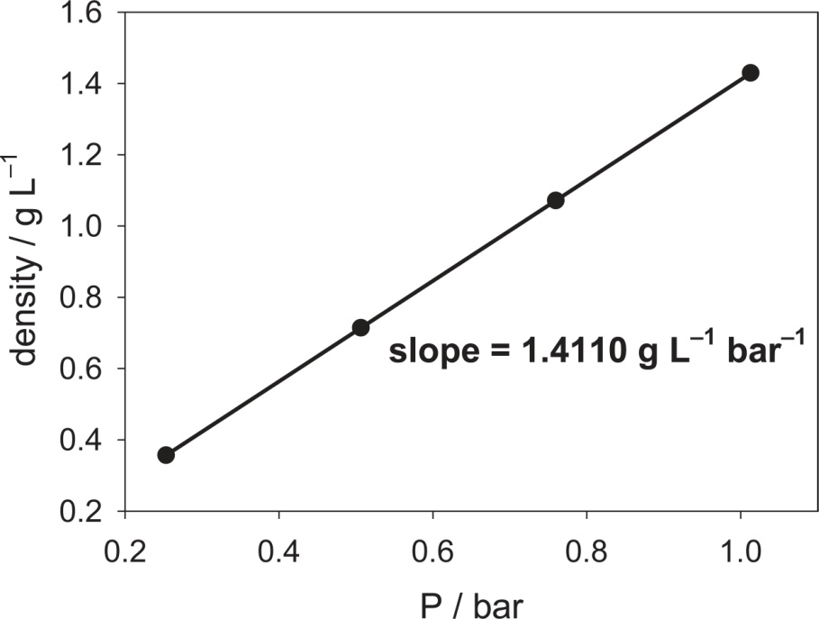
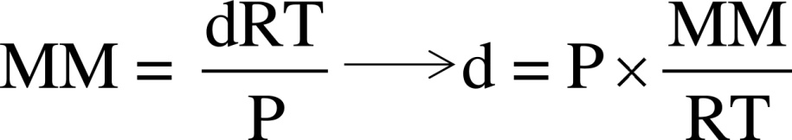
The equation relating density and molar mass of an ideal gas can be rearranged as shown below.
A plot of experimental densities versus pressures is provided to the right for a gas at 273.15 K. Determine the molar mass of the gas.
The identity of the gas could be
a) N₂.
c) O₂.
e) CO.
b) CO₂.
d) N₂O.
Notes:
Answer: c

Slide 29
The equation relating density and molar mass of an ideal gas can be rearranged as shown below.
A plot of experimental densities versus pressures is provided to the right for a gas at 273.15 K. Determine the molar mass of the gas.
The identity of the gas could be
a) N₂.
c) O₂.
e) CO.
b) CO₂.
d) N₂O.
Notes:
Answer: c

Slide 30
Estimate how long it takes a person at rest to breathe one mole of air if the person breathes 85 mL of air at ambient temperature and pressure. (Assume that the breathing rate is 6–8 min^{–1}.)
a) 50–65 minutes
c) 16–33 minutes
e) 1–59 seconds
b) 34–49 minutes
d) 1–16 minutes
Notes:
Answer: b

Slide 31
Estimate how long it takes a person at rest to breathe one mole of air if the person breathes 85 mL of air at ambient temperature and pressure. (Assume that the breathing rate is 6–8 min^{–1}.)
a) 50–65 minutes
c) 16–33 minutes
e) 1–59 seconds
b) 34–49 minutes
d) 1–16 minutes
Notes:
Answer: b

Slide 32
The volume of one mole of gaseous nitrogen at standard temperature and pressure (273.15 K, 1 bar) is 22.71 L. The density of liquid nitrogen at 77 K is 0.808 g mL^{–1}. Calculate the volume of one mole of liquid nitrogen.
Making the assumption that in liquid N₂, there is little empty space, how much empty space is there in one mole of gaseous nitrogen at STP?
a) 0.03 L
c) 20.45 L
e) 22.68 L
b) 0.08 L
d) 22.48 L
Notes:
Answer: e

Slide 33
The volume of one mole of gaseous nitrogen at standard temperature and pressure (273.15 K, 1 bar) is 22.71 L. The density of liquid nitrogen at 77 K is 0.808 g mL^{–1}. Calculate the volume of one mole of liquid nitrogen.
Making the assumption that in liquid N₂, there is little empty space, how much empty space is there in one mole of gaseous nitrogen at STP?
a) 0.03 L
c) 20.45 L
e) 22.68 L
b) 0.08 L
d) 22.48 L
Notes:
Answer: e

Slide 34
If mercury (density = 13.6 g/cm³) at a height of 745 mm Hg in a mercury barometer is replaced with water (density = 1.00 g/cm³), under the same conditions the height of water will be
a) 0.180 ft.
b) 2.44 ft.
c) 33.2 ft.
d) 399 ft.
e) None of above
Notes:
Answer: c

Slide 35
If mercury (density = 13.6 g/cm³) at a height of 745 mm Hg in a mercury barometer is replaced with water (density = 1.00 g/cm³), under the same conditions the height of water will be
a) 0.180 ft.
b) 2.44 ft.
c) 33.2 ft.
d) 399 ft.
e) None of above
Notes:
Answer: c

Slide 36
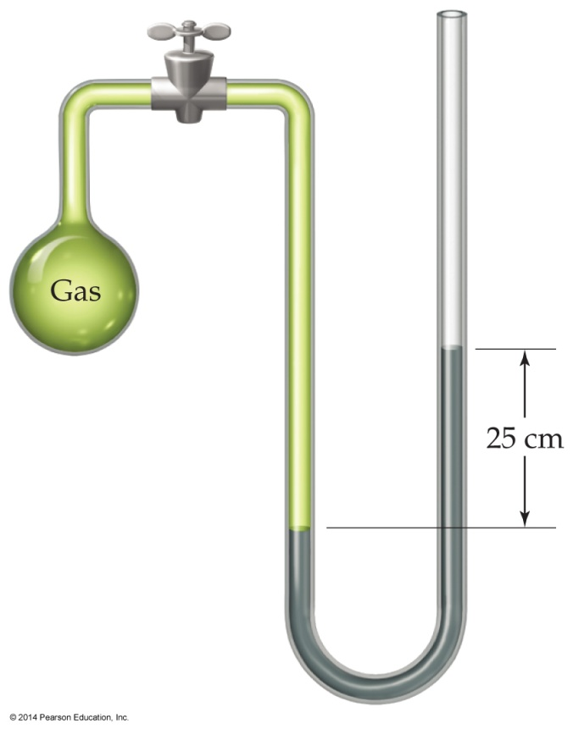
If the pressure in a gas container that is connected to an open-end U-tube manometer is 106 kPa and the pressure of the atmosphere at the open end of the tube is 742 mm Hg, the level of mercury in the tube will be
a) 53 mm higher in the arm open to the atmosphere.
b) 53 mm higher in the arm connected to the gas cylinder.
c) 636 mm higher in the arm open to the atmosphere.
d) 636 mm higher in the arm connected to the gas cylinder.
e) None of the above
Notes:
Answer: a

Slide 37
If the pressure in a gas container that is connected to an open-end U-tube manometer is 106 kPa and the pressure of the atmosphere at the open end of the tube is 742 mm Hg, the level of mercury in the tube will be
a) 53 mm higher in the arm open to the atmosphere.
b) 53 mm higher in the arm connected to the gas cylinder.
c) 636 mm higher in the arm open to the atmosphere.
d) 636 mm higher in the arm connected to the gas cylinder.
e) None of the above
Notes:
Answer: a

